Slide 1
CSE299 WEEK 06
Prepared by
Md. Abdullah Al Jobaer
1512028042

Slide 2
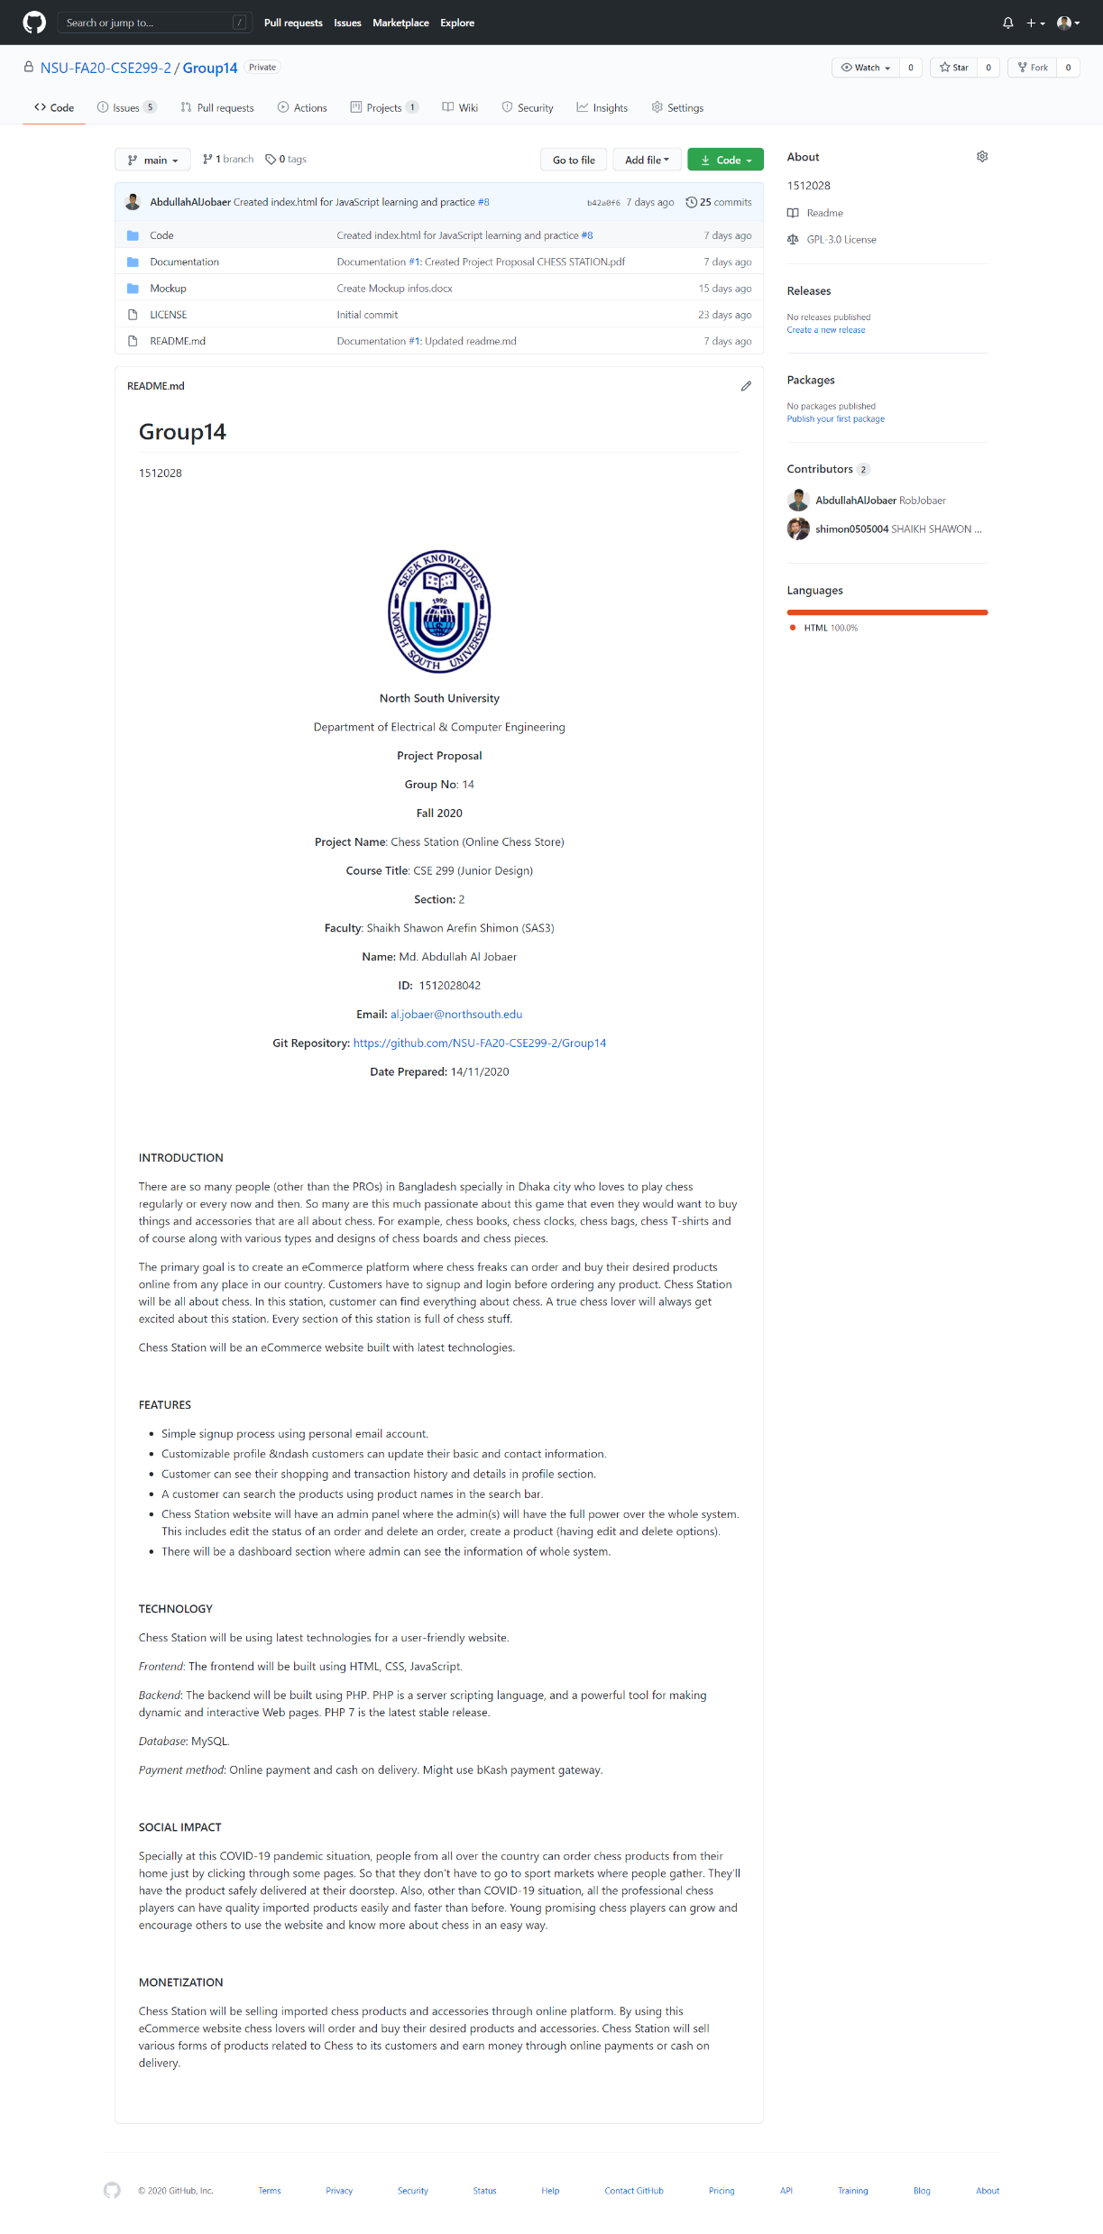
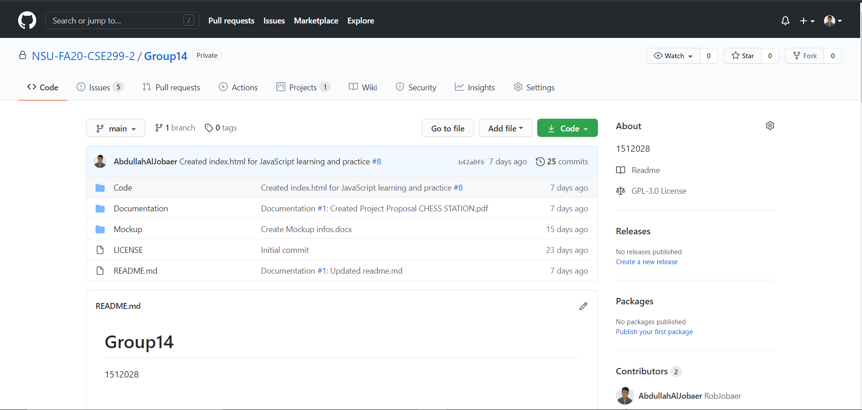
GitHub FRONT PAGE

Slide 3
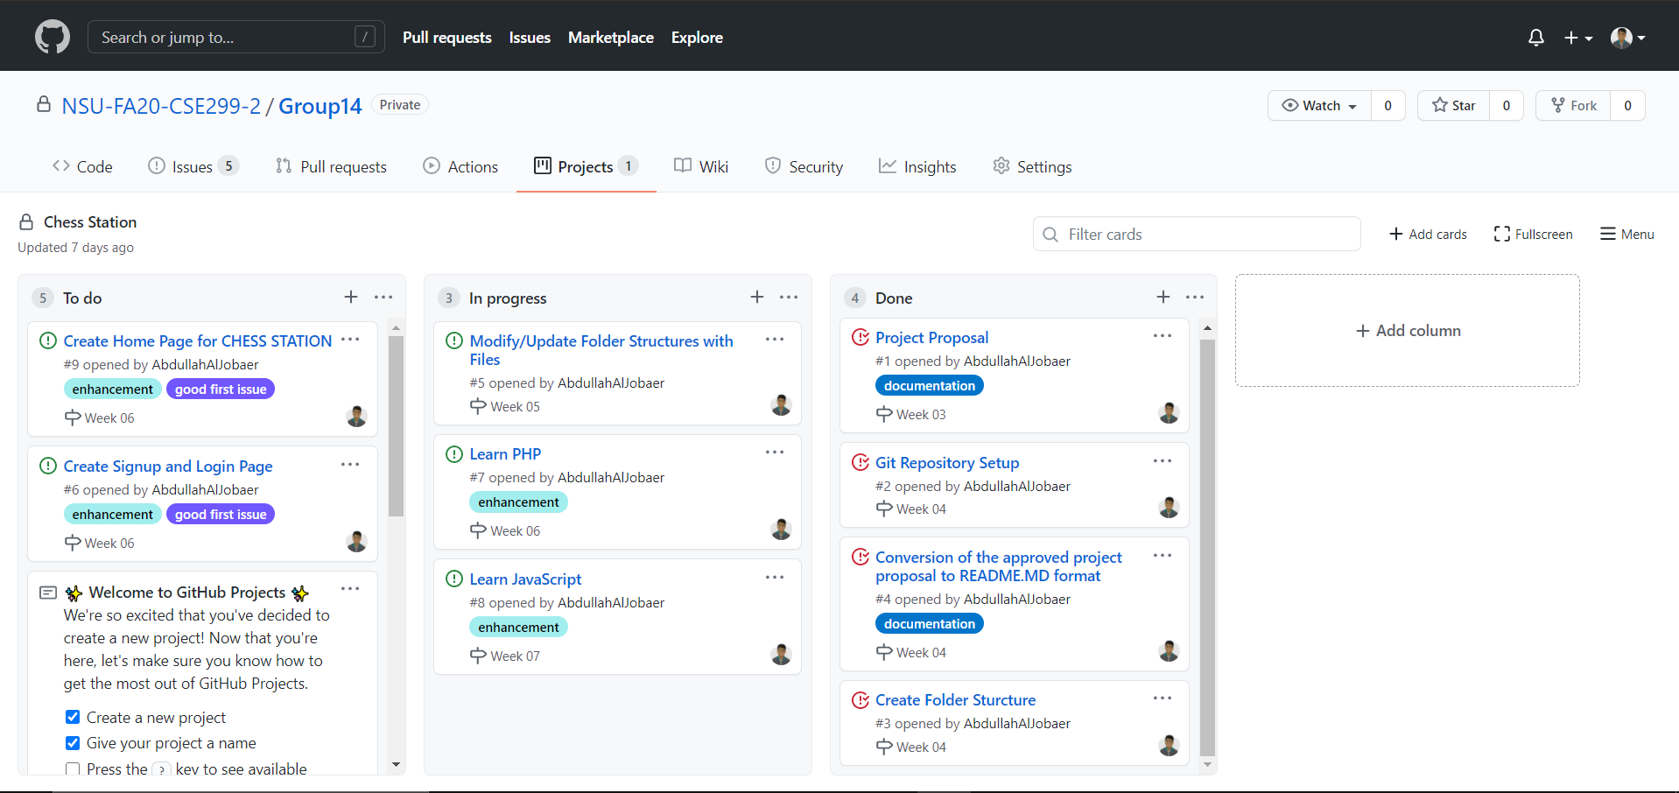
GitHub PROJECT BOARD

Slide 4
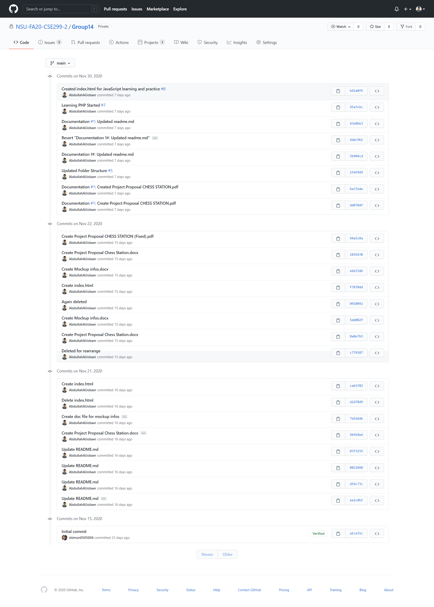
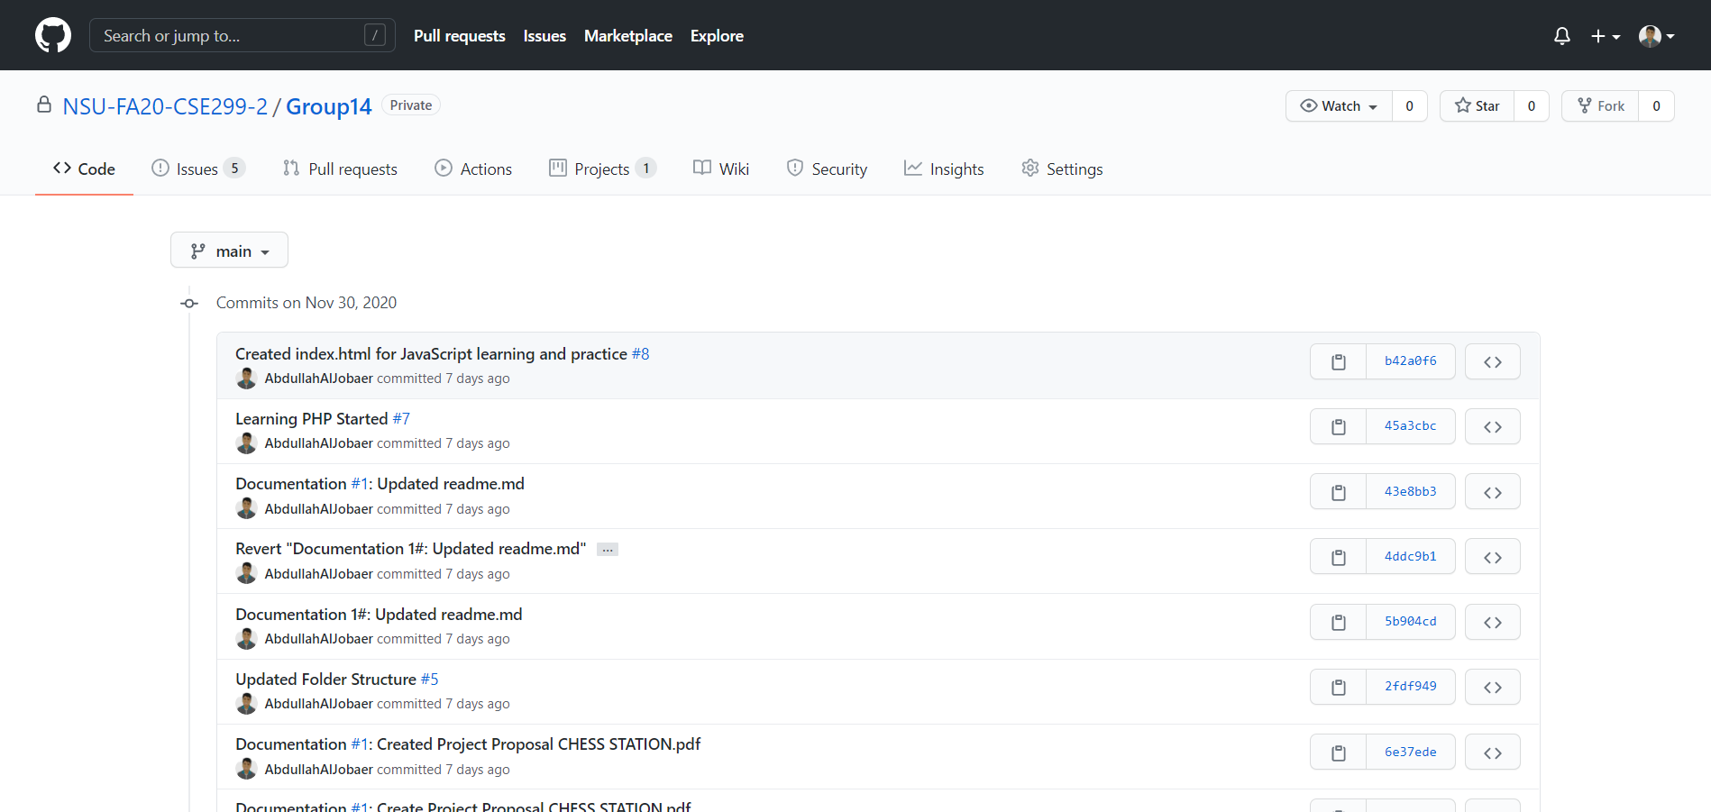
COMMITS

Slide 5
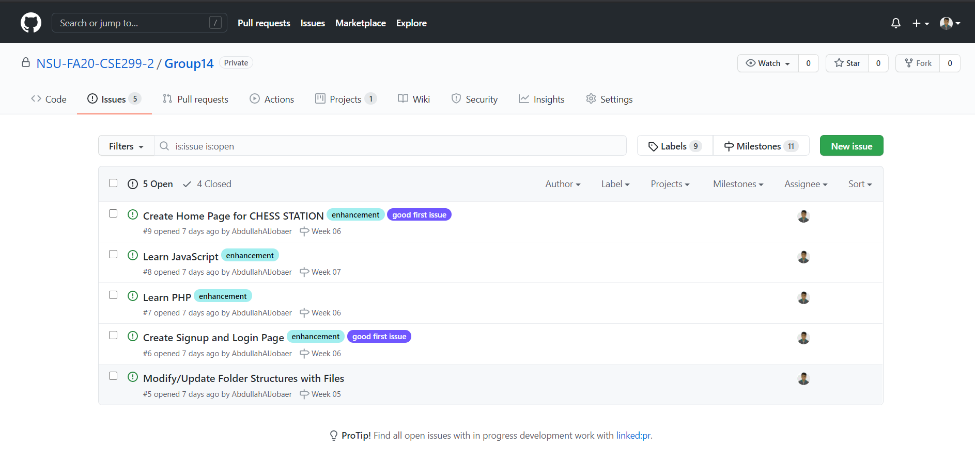
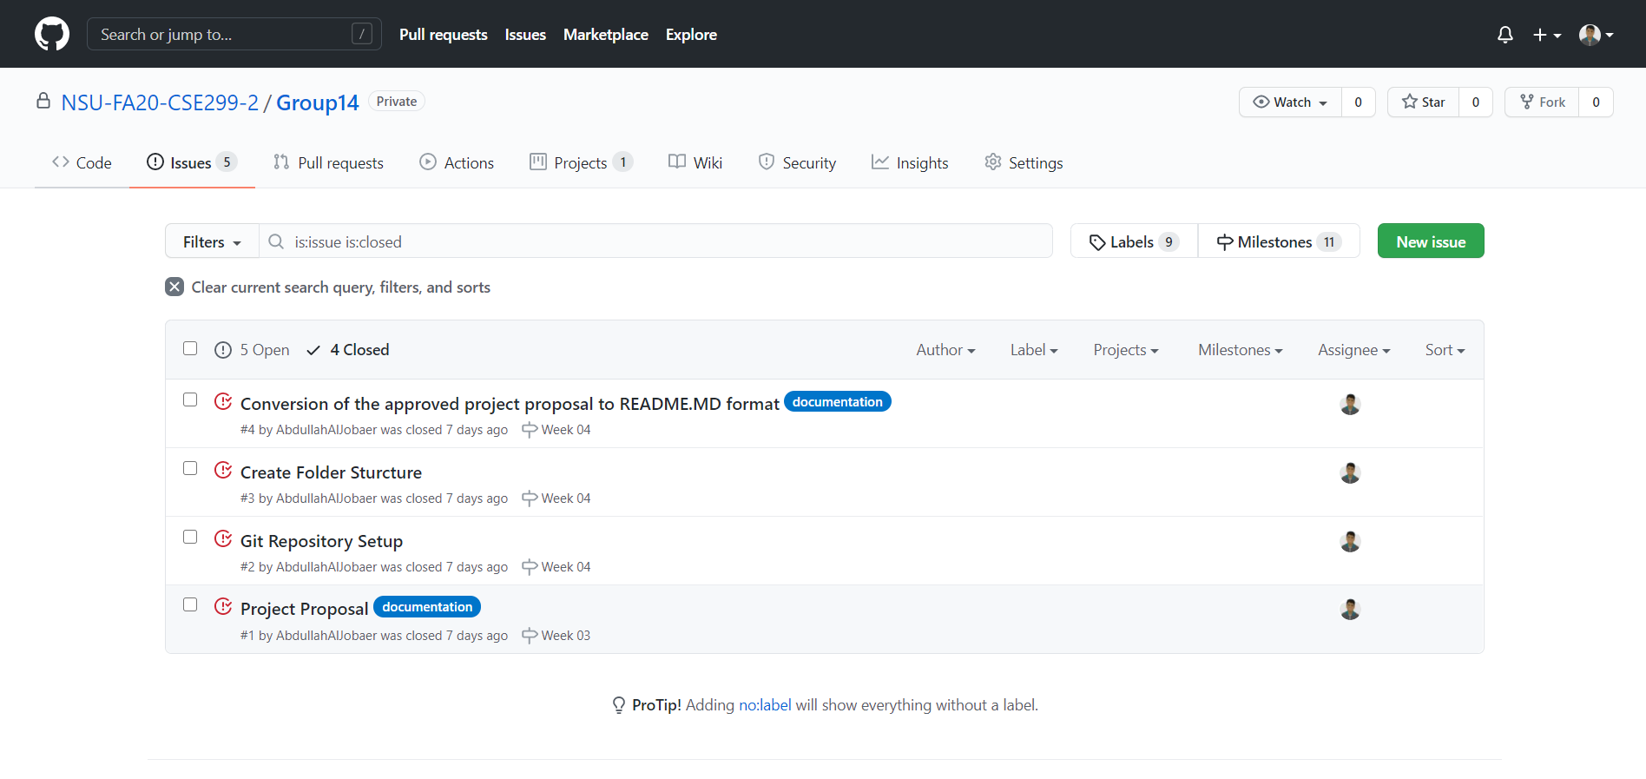
ISSUES
Open Issues:
Closed Issues:

Slide 6
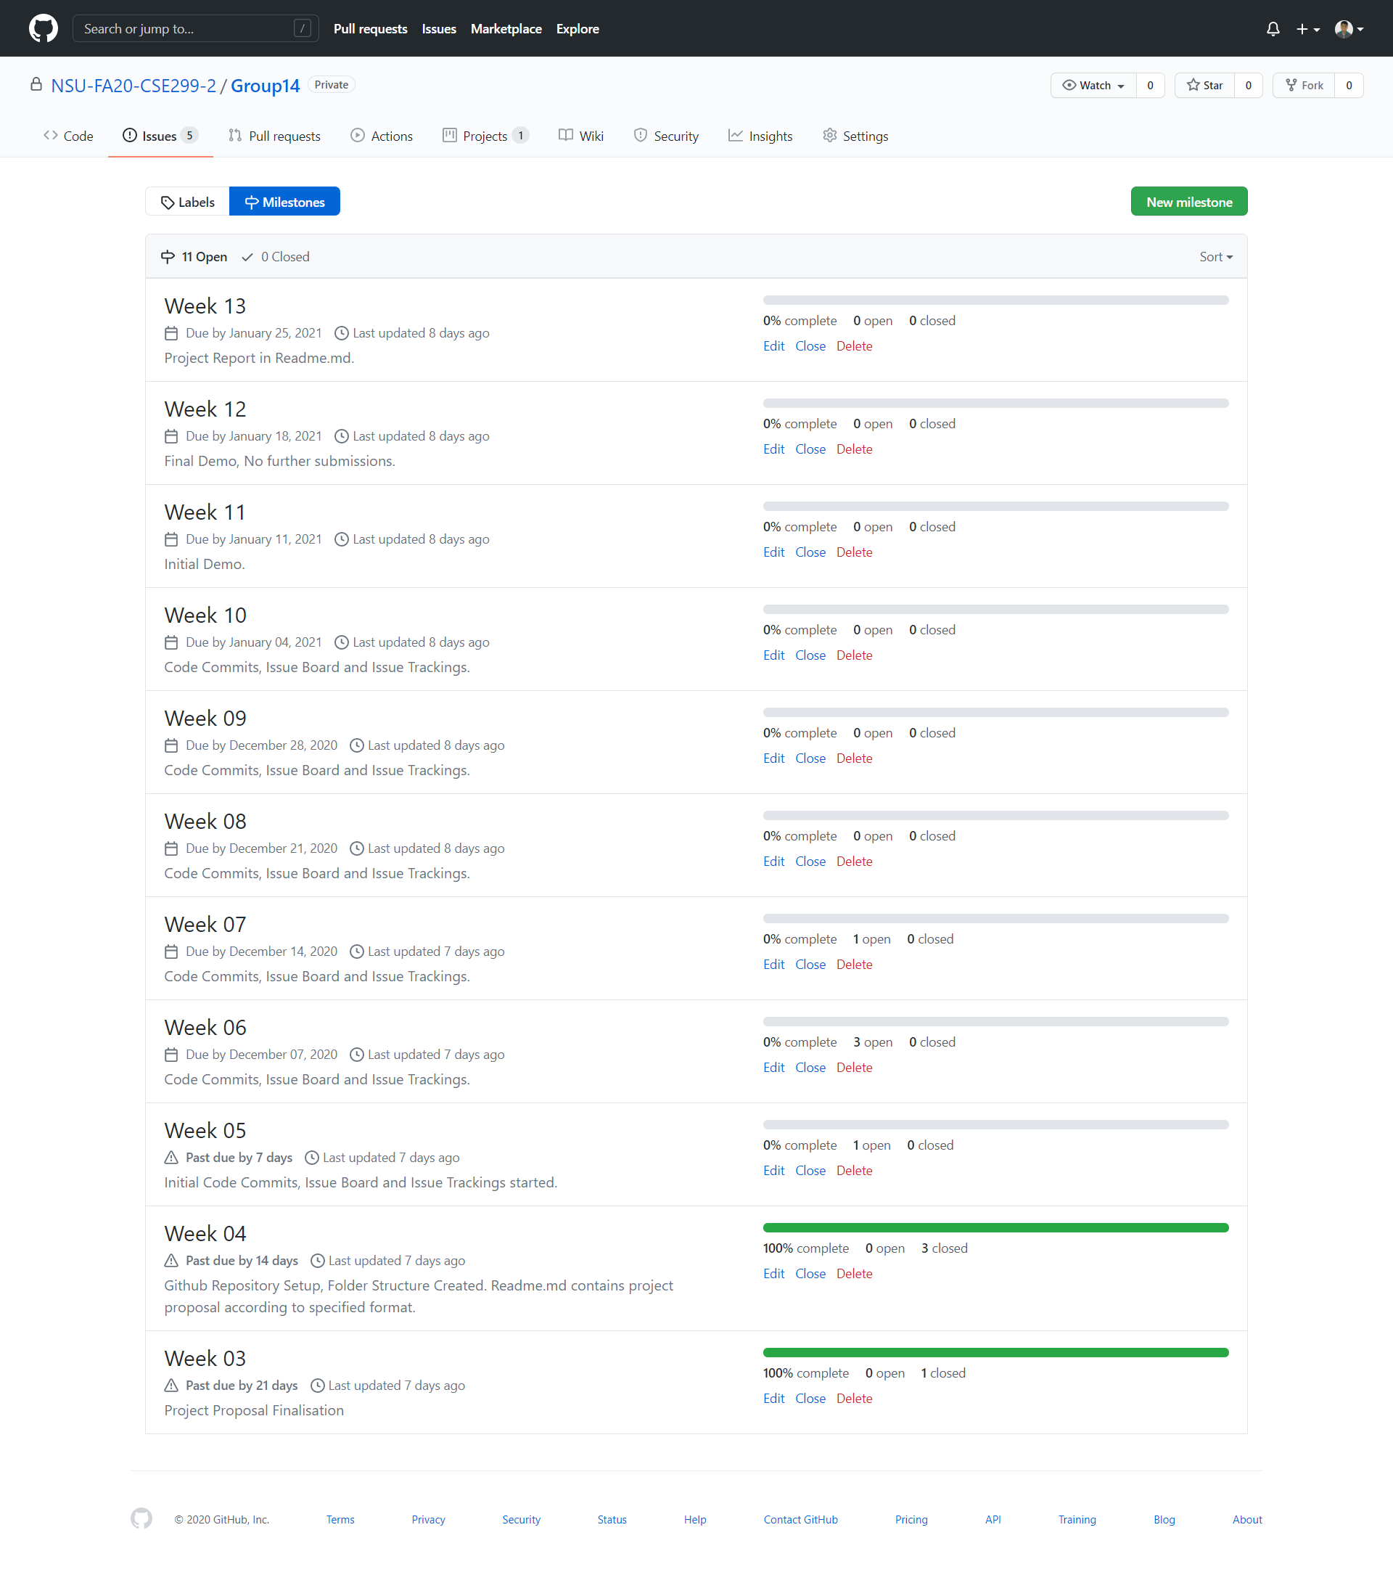
MILESTONES

Slide 7
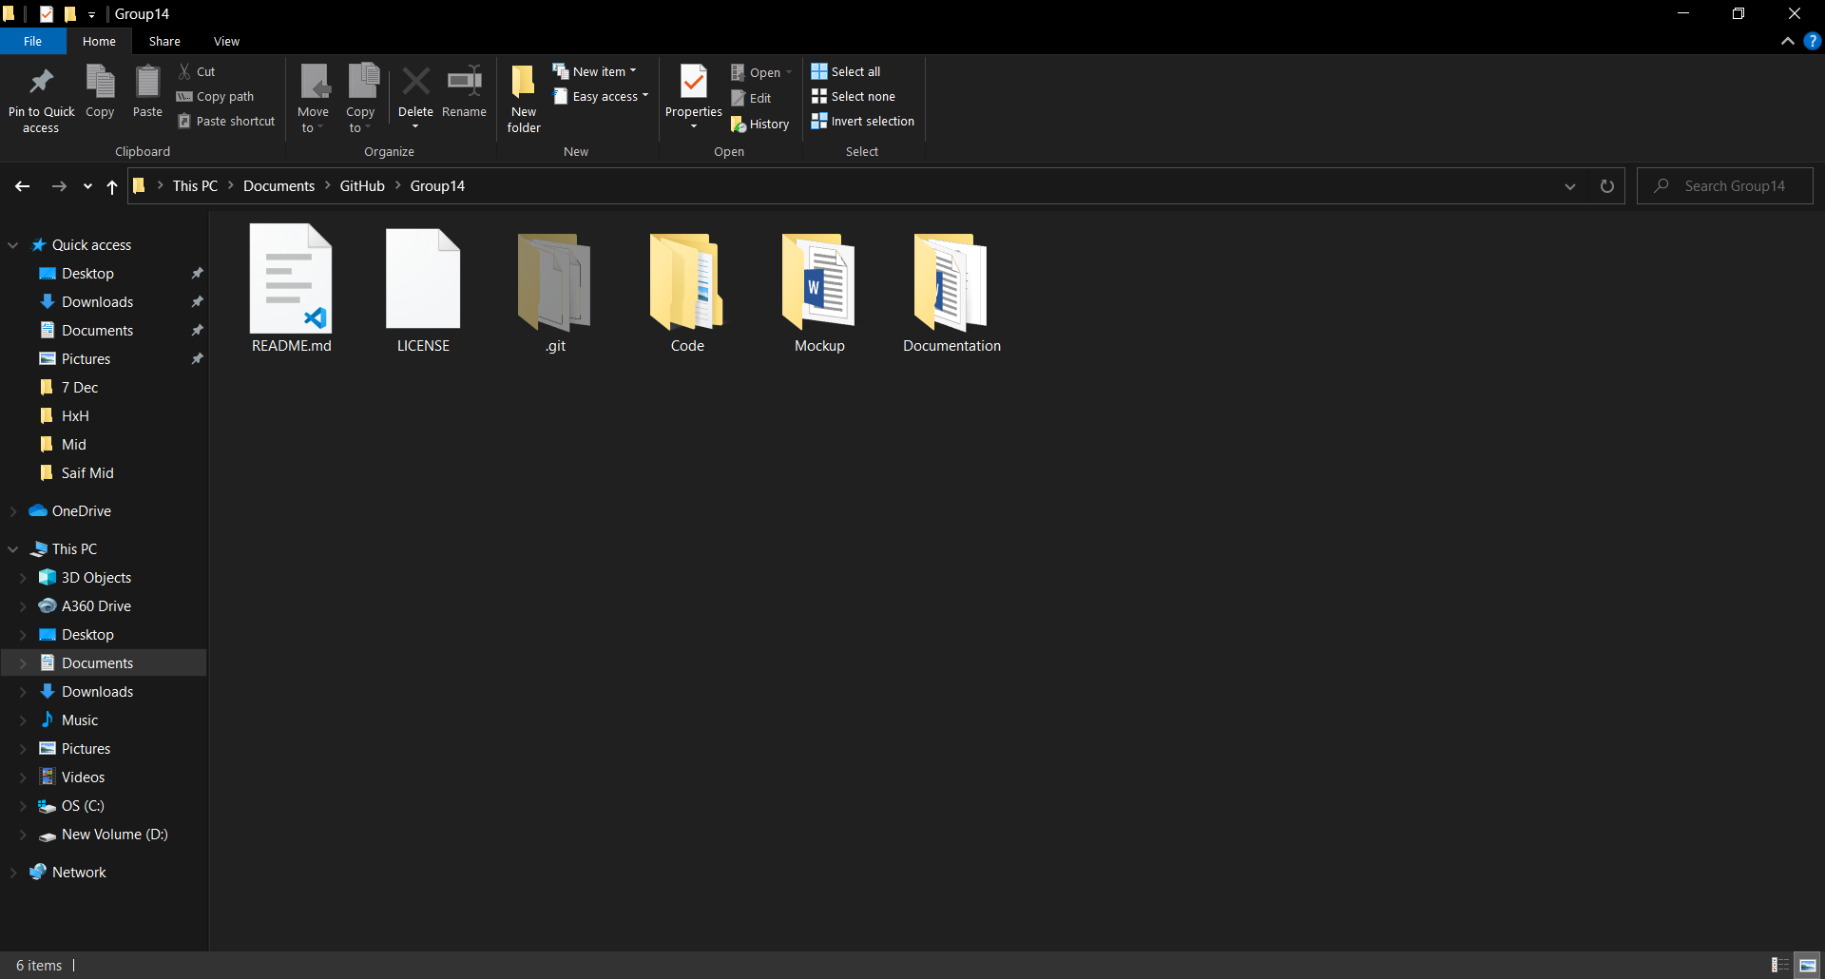
LOCAL REPOSITORY SNAP

